Slide 1

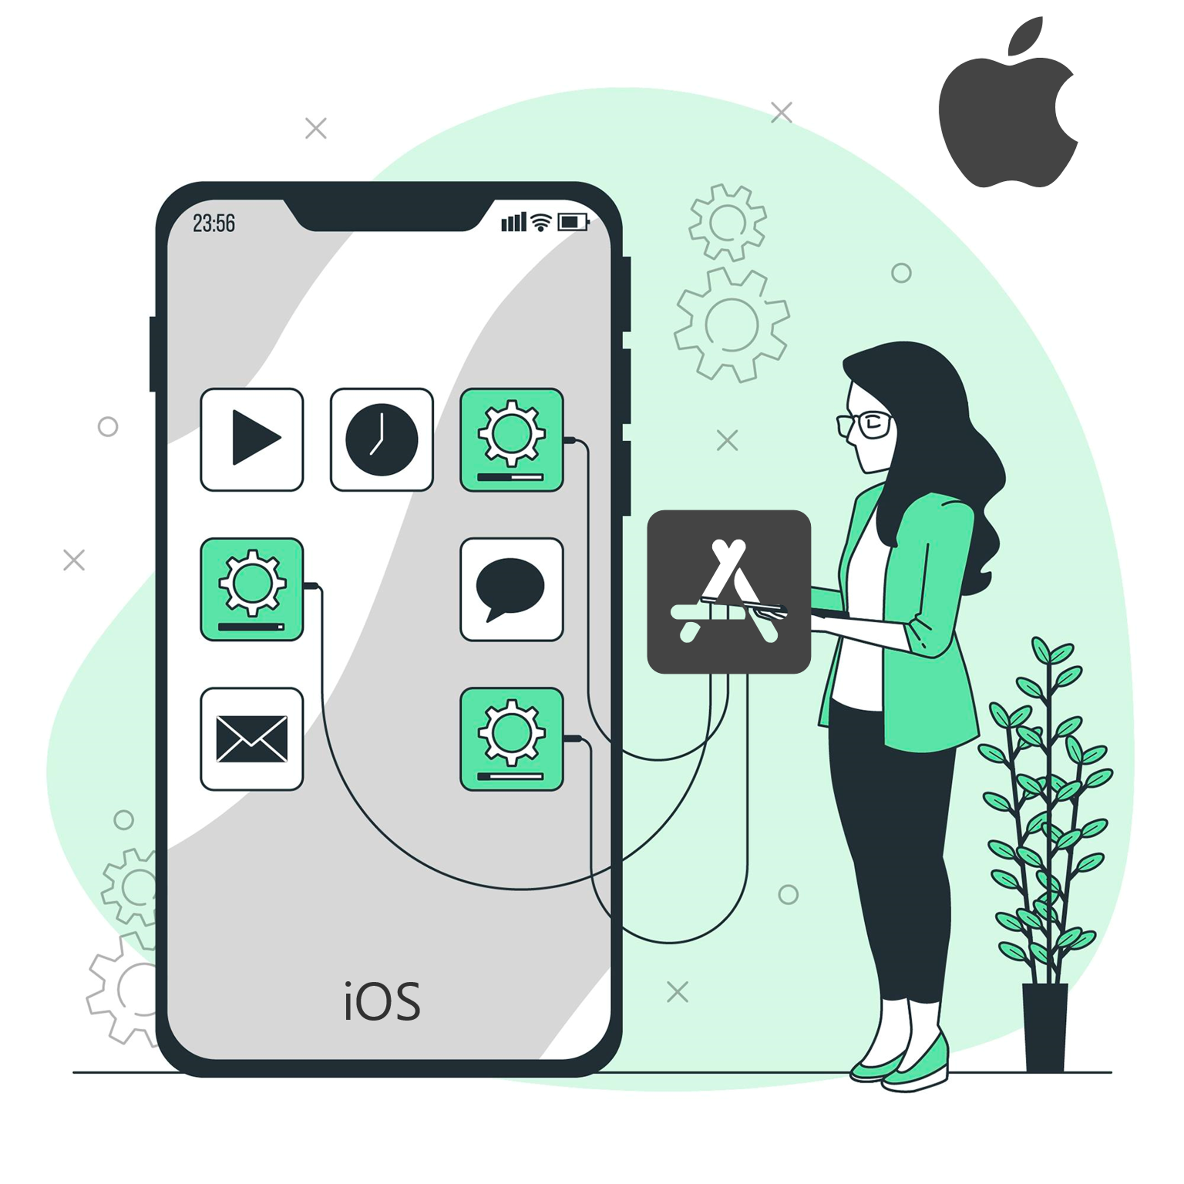
Comprehensive Guide to
iOS App Development
A business app is essential for a developing firm in today’s age of rising technology. Advantages of iOS like low app development cost, features, security & reliability make iOS the most preferred choice.

Slide 2
Why Should a Company Select iOS Platform for App Development?
Excellent Customer Service
Apple has established a strong brand in consumer electronics due to its superior equipment, outstanding customer service and faultless programming.
Apple’s User Interface
Apple users always appreciate their devices’ regulated surroundings. They also appreciate the simple and engaging UI of iOS apps.
Attracting a Tech-Savvy Audience
The iPhone has always been a popular device among tech-savvy consumers. If you create an iOS App for your business then it will help your firm to boost brand recognition.
Source: https://www.weblineindia.com/blog/ios-app-development-guide/

Slide 3
Why Should a Company Select iOS Platform for App Development?
Increased Market Penetration in Leading Countries
iPhones are quite popular in countries such as the United States and the United Kingdom and having an iOS app allows the firm to expand its business in such countries.
High Security and Secure Transactions
iPhone users are safe from outside threats. iOS has a strong defense against external dangers such as viruses and malware, making it more appealing for businesses to select iOS over Android apps.
High ROI
Using iOS app development services to build iOS apps can help a company build reliable customers with increased income and ROI and expand the reach of the business with greater value.
Source: https://www.weblineindia.com/blog/ios-app-development-guide/

Slide 4
Factors That Affect iOS App Development Cost
Project Difficulty
Project complexity is the most important element influencing the cost of iOS app development. The cost rises in direct proportion to the project’s complexity and the features implemented in the app.
Features
The most noticeable component that has a big impact on the entire cost of iOS app development is the features. Adding more features to your app will increase the cost of its development.
Infrastructure in the Backend
The backend is a server that runs software & allows the app to communicate with external data. While you create an iOS app, you will need backend infrastructure to sync the features with the internet.
Source: https://www.weblineindia.com/blog/ios-app-development-guide/

Slide 5
Factors That Affect iOS App Development Cost
Development Team Location
When dealing with a large app development firm, the cost of iOS app development may be higher. With an independent developer may cost you less because there are fewer people involved in the process.
Cost of App Upkeep
Post-launch app maintenance is another key aspect that influences overall iOS app development cost. You should not overlook this critical feature if you want your iOS app to be successful.
Source: https://www.weblineindia.com/blog/ios-app-development-guide/

Slide 6
Factors That Affect iOS App Development Cost
Hidden Costs
Aside from the aforementioned, a few hidden costs influence the overall cost of iOS app development, including:
Hosting
Architecture
Monitoring
Licenses
Updates to the application
Subscription Fees for Third-Party APIs
Source: https://www.weblineindia.com/blog/ios-app-development-guide/

Slide 7



iOS App Development Trends
Machine Learning Will Become More Popular
Apple has been enabling the developer community to expand their apps with intelligent features using just a few lines of code in the context of iOS development, all due to Core ML.
Augmented Reality
Apple provides incredibly powerful and feature-rich frameworks, such as ARKit and RealityKit, as well as tools, such as Reality Composer & Reality Converter, which can be used to bring the most innovative and demanding ideas to life in Augmented Reality.
Apple Pay
Apple Pay is undoubtedly the best way to pay. A company is based in USA, UK or elsewhere in the world, it will be critical for businesses and even developers to ensure that their iOS apps support this service.
Source: https://www.weblineindia.com/blog/ios-app-development-guide/

Slide 8


iOS App Development Trends
The Rise of IoT
HomeKit is at the forefront of IoT innovation in the realm of iOS app development. Using HomeKit’s features, households may construct different scenes to manage these gadgets by grouping with Siri’s help.
Swift 5
Apple designed Swift, a relatively intuitive programming language. Swift 5.1 is the most recent version that has been officially released. Swift 5.1 simplifies and rewards iOS app development with new features that extend the capabilities of the language and standard library.
Source: https://www.weblineindia.com/blog/ios-app-development-guide/

Slide 9
Advantages of iOS App Development for Startups
Despite accounting for 75% of the smartphone market, iOS consumers are more likely to pay for an app than Android users.
More Paying Customers
Each iOS app runs smoothly on an iPhone, providing a wonderful user experience and increasing the app’s engagement rate with its customers.
Engagement
Android apps are not profitable for a startup because they yield less than 10% of the entire cost of development. Whereas iOS apps can be beneficial for a business by guiding it toward healthier finances through greater revenue and ROI.
Revenue iOS
Source: https://www.weblineindia.com/blog/ios-app-development-guide/

Slide 10
Reasons to Choose Custom iOS App Development Services Over Others?
Ensured the Best End-User Experience
iOS provides customers with a fluid, effortless and perfect user experience that is founded on high-quality hardware and software functionalities.
Raised Security Standards
iOS virtually eliminates the possibility of rogue software and keeps security at the forefront of everything. All apps on the Apple Software Store often go through a lengthy and stringent testing procedure to ensure a fully safe app.
Fragmentation of Superior Devices
With a limited number of Apple iPhones, iOS provides a much clearer method for this. Apple iOS Simulator enables iOS development firms to test apps under various iOS versions and hardware configurations.
Source: https://www.weblineindia.com/blog/ios-app-development-guide/

Slide 11
Reasons to Choose Custom iOS App Development Services Over Others?
Rapid and Cost-effective Development Process
In comparison to other operating systems, iOS is faster, easier and less expensive to create. iOS apps take 30-40% less time to load than Android apps.
Years of Faster Software Updates
Apple typically provides fresh updates for new iPhones & other iOS devices for at least 5 to 6 years after their initial release. All of those iOS devices are receiving the most recent updates at the same time.
Source: https://www.weblineindia.com/blog/ios-app-development-guide/

Slide 12
Consideration Factors While Choosing an iOS App Development Company
Expertise in Your Field
The best option is to go with a business that understands how apps in your industry should function and look. They will provide better recommendations and will require less time to construct an app.
Identify Cost-Effective Regions
In this scenario, cost-effectiveness does not imply the lowest. There are countries with extremely cheap pay rates, however, they do not provide the highest quality.
Fit with the Company Culture
It is critical to select a provider with which you are completely comfortable. Consider the culture of the country in which the company of your choice is based.
Source: https://www.weblineindia.com/blog/ios-app-development-guide/

Slide 13
Consideration Factors While Choosing an iOS App Development Company
Examine your Portfolio and Testimonials
Customer reviews are provided on numerous forums and directories that should be used to select an iOS app development company.
After-Sales Service
You must carefully choose a company providing offshore custom iOS app development services, that will be providing you with services post-sale.
Source: https://www.weblineindia.com/blog/ios-app-development-guide/

Slide 14

Conclusion
THANK
YOU
Top custom iOS app development firms will design and develop iOS apps with a greater emphasis on new & emerging technologies such as ML, AR, VR, IoT and Apple Pay. Businesses will also require custom app development service providers they can rely on to assist them in developing more powerful, scalable and cost-effective apps.
CONTACT US
+1-213-908-1090 (USA)
+61-2-8011-4668 (AUS)
+44-207-193-7507 (UK)
+91-79-26420897 (IND)
EMAIL
WEBSITE
info@weblineindia.com
www.weblineindia.com

