Slide 1




Guide to Reduce eCommerce Website Development Cost for Store Owners

Slide 2


E-commerce design and development is a huge booming industry. Thousands of entrepreneurs outsource website design and development services to an offshore company. E-commerce website or app development prices depend on the demand and competition in the market.
Source:
https://www.weblineindia.com/blog/guide-to-reduce-ecommerce-website-development-cost/

Slide 3
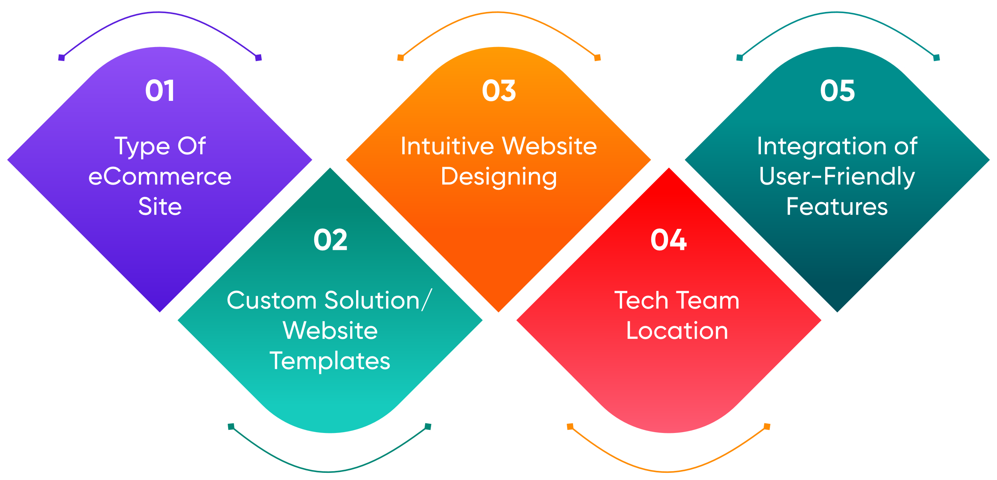

Factors Affecting eCommerce Website Development Price
In addition to these, there are other cost-driven factors in eCommerce website development, such as domain name, hosting, SSL certificate, maintenance, and marketing.
Source:
https://www.weblineindia.com/blog/guide-to-reduce-ecommerce-website-development-cost/

Slide 4
How to reduce eCommerce website development cost?
Have a Plan
If you want to save the cost of the app and website development, it is vital for you to have a robust plan in the first place. This will aid in opting for the best and reducing the cost of unwanted ones.
Try to Reduce the Scope of Your eCommerce Website Development
It would be great if you could start with MVP or Minimum Viable Product. This comes with loads of added advantages like being able to create a product that will set your business in motion without an exultant budget.
Source:
https://www.weblineindia.com/blog/guide-to-reduce-ecommerce-website-development-cost/

Slide 5
How to reduce eCommerce website development cost?
UAT In the First Place
User Acceptance Tests (UAT) are highly recommended in the initial stage. If you learn after launching your app in the store that users are not accepting it, then resolving these issues at that stage would be extremely expensive.
Utilize Available Templates
After determining a plan, your next step should be planning an interface. This is what will help your customers to associate your brand with. Many businesses and people produce simple designs and later sell them as website templates. These ready-made templates lower the website development price.
Source:
https://www.weblineindia.com/blog/guide-to-reduce-ecommerce-website-development-cost/

Slide 6
How to reduce eCommerce website development cost?
Reduce Domain and Hosting Costs
A domain name is essential for two reasons: first, to store the data centrally (login and registration, etc), and second, because you need a domain verified as the owner for platforms like Google Apps.
If you do not get the perfect domain name at the beginning stage, you can invest in it in the future by purchasing it later.
Source:
https://www.weblineindia.com/blog/guide-to-reduce-ecommerce-website-development-cost/

Slide 7
Build A Cross-Platform App
If you wish to develop your eCommerce website app for different platforms like Android and iOS, the best solution would be to stick to cross-platform app development. It is helpful in reducing the cost as it is easy to update.
1. Getting the Right Tech Stack
The tech stack consists of a set of programming languages, tools, and frameworks that are utilized to build your eCommerce apps and websites. You should keep your rear stack simple and not get swept off by the latest technologies or software if you are willing to save the website development price.
Source:
https://www.weblineindia.com/blog/guide-to-reduce-ecommerce-website-development-cost/

Slide 8
Build A Cross-Platform App
2. Choose the Right Hosting Plan
It’s crucial for you to hire the best website development company when heading to choose your hosting plan. The hosting plan needs to sync with the requirements of your app; otherwise, there would be glitches, which would add to the web development cost.
3. Outsource eCommerce Website Design and Development
Outsourcing is a practical solution if you want the developer’s team to focus on the core business functions solely. You can rely on the expertise and experience of some of the best available website development companies that can meet your expectations and requirements.
Source:
https://www.weblineindia.com/blog/guide-to-reduce-ecommerce-website-development-cost/

Slide 9
Final Verdict
The best method of creating a successful brand is by creating an eCommerce website. However, it takes the proper estimate and knowledge to assess the cost of making a website. Using the above-mentioned strategies, you can save on costs and time and still create a high-quality and flawless website for your business.
Source:
https://www.weblineindia.com/blog/guide-to-reduce-ecommerce-website-development-cost/

Slide 10

Thank You
CONTACT US
EMAIL
+1-213-908-1090 (USA)
+91-79-26420897 (IND)
info@weblineindia.com
WEBSITE
www.weblineindia.com

