Slide 1
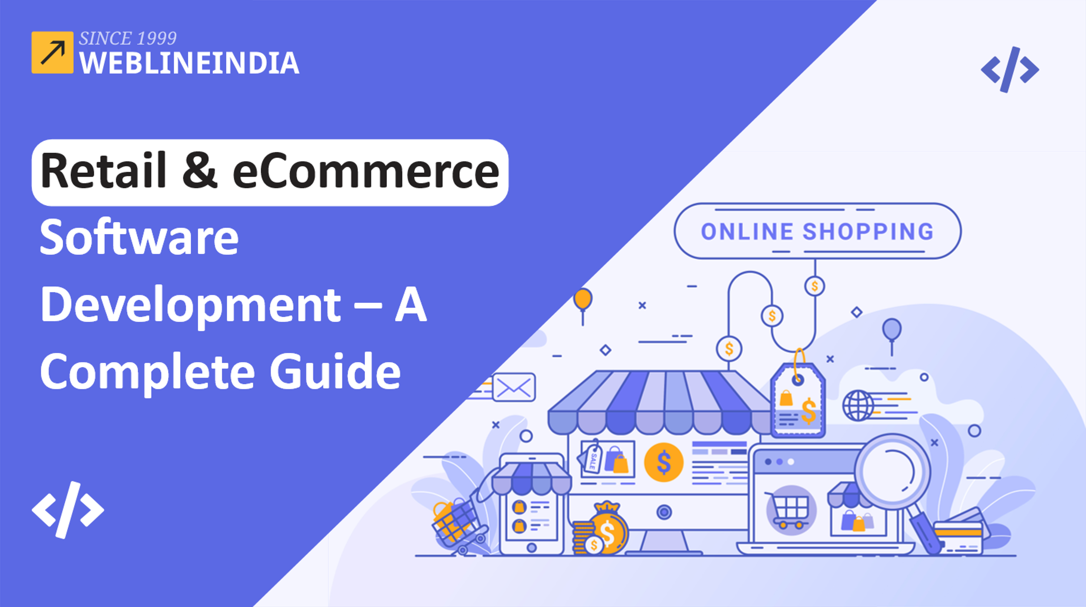

Slide 2

eCommerce and retail software is used to run eCommerce and retail operations. eCommerce software is used to manage all of the orders placed by customers, as well as shipping, tracking, inventory management and so on. You may also manage all of your clients, consumers, items, and more with retail software.
Source: https://www.weblineindia.com/blog/retail-ecommerce-software-development-guide/

Slide 3
Benefits of Retail and eCommerce Software Development
Customised Options
Retailers may design an eCommerce site that looks and feels like their physical store. An outsourced staff can execute projects considerably more quickly than an in-house team. This is due to their greater access to resources, know-how, and expertise.
Increased Customer Satisfaction
Implementing a sophisticated eCommerce website will assist customers in finding what they are looking for and makes the purchasing process easier. It will also enable you to track consumer behaviour and generate leads for future sales.
Source: https://www.weblineindia.com/blog/retail-ecommerce-software-development-guide/

Slide 4
Benefits of Retail and eCommerce Software Development
Sales Growth
A well-designed eCommerce website can assist you in reaching more clients and increasing income. Many retailers use ecommerce software built by an eCommerce web design & development company to boost sales.
Reduced Expenses
eCommerce website can be built up totally online and hosted on servers using cloud technologies. This also eliminates the need for costly storefronts in shopping malls or other retail sites, resulting in significant cost savings over time.
Source: https://www.weblineindia.com/blog/retail-ecommerce-software-development-guide/

Slide 5
Benefits of Retail and eCommerce Software Development
Brand Image and Reputation Enhancement
A well-designed eCommerce platform that is built by a firm providing software development services will assist you in improving the exposure of your brand among potential clients by increasing awareness of the items or services you offer via social media.
Source: https://www.weblineindia.com/blog/retail-ecommerce-software-development-guide/

Slide 6
eCommerce Industry Trends 2022
Content Localisation
Today customers have so many options available at the press of a button. This includes adding local flair and developing tailored infrastructure for each market segment in which the brand sells its products.
Automation of eCommerce, Chatbots and Interactive Products
Automation of eCommerce is a rapidly growing part of online business. AI and chatbots have grown in popularity over the previous five years and technological advances predict that this trend will continue.
Source: https://www.weblineindia.com/blog/retail-ecommerce-software-development-guide/

Slide 7
eCommerce Industry Trends 2022
Visual Stimuli
AR and VR devices are becoming more inexpensive as a result of initiatives such as Google Cardboard. Retailers can start experimenting with innovative AR/VR strategies. Hence making visual stimuli is one of the important eCommerce trends in 2022.
Omnichannel Shopping Experience
The majority of organisations that have websites and social media channels engage with their customers through multi-channel user experiences. This is where an omnichannel strategy comes in since it offers a holistic approach that ensures a uniform user experience across all purchasing channels.
Source: https://www.weblineindia.com/blog/retail-ecommerce-software-development-guide/

Slide 8
How Do You Create Retail and eCommerce Software?
Many organisations now require retail and eCommerce software development. Any retail or eCommerce project’s development phase can be quite complex. It entails developing a detailed plan that covers everything from design and functionality to marketing tactics and corporate objectives.
Source: https://www.weblineindia.com/blog/retail-ecommerce-software-development-guide/

Slide 9

Conclusion
Retail & eCommerce software has become critical to the day-to-day operations of many online companies. It is a large task that necessitates a high level of knowledge and experience. So, when you choose a firm for retail & eCommerce software development, make sure they have prior expertise working on retail software.
Source: https://www.weblineindia.com/blog/retail-ecommerce-software-development-guide/

Slide 10

THANK YOU
CONTACT US
+1-213-908-1090 (USA)
+61-2-8011-4668 (AUS)
+44-207-193-7507 (UK)
+91-79-26420897 (IND)
EMAIL
WEBSITE
info@weblineindia.com
www.weblineindia.com

